Slide 1
Smart fabrics

Slide 2
Content
Introduction
What is a Smart fabric?
Gore-tex
Micro-encapsulated fibre/fabrics
Odour Eaters
Medical Materials
Implementation
Conclusion
References

Slide 3
Introduction
Smart fabrics are ones which can change/react automatically to their surroundings. Smart fabrics (-or intelligent textiles) are being developed to be able to sense what is happening to the wearer or its immediate surroundings. An example of this would be its capacity to know when the wearers heart rate spikes or drops unexpectedly, then being able to send such information to a paramedic of some description

Slide 4
What is a Smart fabric?
Smart materials or textiles can be defined as the materials and structures which have sense or can sense the environmental conditions or stimuli, whereas intelligent textiles can be defined as textile structures which not only can sense but can also react and respond to environmental conditions or stimuli. These stimuli as well as response, could be thermal, chemical, mechanical, electric, magnetic or from other source.

Slide 5
Gore-tex
Gore-tex is a waterproof/breathable fabric that is manufactured from PTFE into a laminated membrane
Properties: breathable, lightweight, waterproof. When worn gore-tex releases watervapour(sweat) from the body but stops raindrops entering
It is used in a range of high performance products such as medical implants, filter media, insulation for wires and cables, gaskets, and sealants. However, Gore-Tex is used mostly in outdoor and all weather clothing.

Slide 6
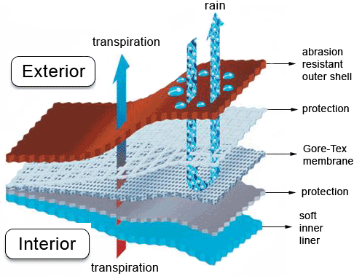

Slide 7
Micro-encapsulated fibre/fabrics
Microencapsuted textiles describes fabric which has microcapsules embedding in the fibres. These capsules contain either solids or liquids which can be controlled to bleed due to a environmental change e.g friction, pressure or gradually by diffusion or during the process of biodegradation.
Some common uses of Micro-encapsulatied fabrics are antibacterial socks, anti-body odour underwear and largely in medical textiles.

Slide 8
Temperature Sensitive Textile
The fundamental job of clothes is to keep us warm or cool, so it's no surprise that many of the smart textiles entering the market look to regulate body teJunor Campbell design and development manager for Mountain Designs says its hats, beanies and jackets are often treated with paraffins.
"Paraffin changes its character. As you get hot it becomes more liquid and all that heat to pass out," says Campbell. "As the body gets cold it solidifies and keeps heat back with the wearer."

Slide 9
Reinventing Wool
Thanks to the advent of smart textiles, the next generation of wool fabrics called 'moisture wicking products' help to keep the body dry by pulling moisture away from it.
"Wool has a great ability to absorb liquids and gases," says Gary Robinson manager of processing technologies for Australian Wool Innovators. "It can take up to a third of its own weight in liquid vapours. It's used a lot in active sportswear; it keeps you feeling comfortable."

Slide 10
Odour Eaters
Smart fabrics are not just working to keep our temperature balmy. Fabrics are being treated with all sorts of substances. Personal hygiene issues, for example, could potentially go the way of the horse and cart as fabrics with anti-bacterial treatments become more common.
Relegating body odour to the history books is just the tip of where fabrics are heading in the beauty stakes. Microencapsulation technology, which allows a whole swathe of substances including aloe vera, vitamins or insect repellents to be added to the fabric, is creating endless possibilities.

Slide 11
Medical Materials
Paff says the best fit for microencapsulated fabrics is medical treatments, especially in the natural health sector. Already, European women are able to continue their war against ageing by wearing tights enriched with substances purported to reduce cellulite.
At the Avantex international forum on innovative textiles earlier this year, delegates were told about research work looking to isolate the chemical properties of gold fly maggots that are known to combat wound infection. The chemical could then be added to the dressing, a much easier solution than current method of packing the maggots in special textile bags, which are then added to the wound.

Slide 12
Materials
For years the textile industry has been weaving metallic yarns into fabrics for decorative purposes. The first conductive fabric we explored was silk organza which contains two types of fibers which are
1. Plain silk thread
2. Silk thread wrapped in thin copper foil

Slide 13
Micrograph of silk organza
This metallic yarn is prepared just like cloth-core telephone wire, and is highly conductive. The silk fiber core has a high tensile strength and can withstand high temperatures, allowing the yarn to be sewn or embroidered with industrial machineryCircuits fabricated on organza only need to be protected from folding contact with themselves, which can be accomplished by coating, supporting or backing the fabric with an insulating layer which can also be cloth. Also, circuits formed in this fashion have many degrees of flexibility (i.e. they can be wadded up), as compared to the single degree of flexibility that conventional substrates can provide

Slide 14
Implementation
Several circuits have been built on and with fabric to date, including busses to connect various digital devices, microcontroller systems that sense proximity and touch, and all-fabric keyboards and touchOne kind of fabric keyboard uses pieced conductive and nonconductive fabric, sewn together like a quilt to make a row- and column-addressable structure. The quilted conductive columns are insulated from the conductive rows with a soft, thick fabric, like felt, velvet, or quilt batting. pads.

Slide 15
Conclusion
We have shown how to combine conventional sewing and electronics techniques with a novel class of materials to create interactive digital devices. All of the input devices can be made by seamstresses or clothing factories, entirely from fabric. These textile-based sensors, buttons, and switches are easy to scale in size. They also can conform to any desired shape, which is a great advantage over most existing, delicate touch sensors that must remain flat to work at all. Subsystems can be connected together using ordinary textile snaps and fasteners. Finally, most of what has been described can be thrown in the wash if soiled by coffee, food, or sand at the beach.

Slide 16
Thanks

